Slide 1
MARK 2200-01
Final Portfolio
Riad Issa

Slide 2


Company plan
FASA (Parent)
  Style Guide
  Newsletter
  Company video
Physio Train (Subsidiary)
  Homepage
  Company flag
Soul Training Facility (Fictitious)
  Product label
oul
Training facility
Fictitious company

Slide 3

Company Plan

Slide 4
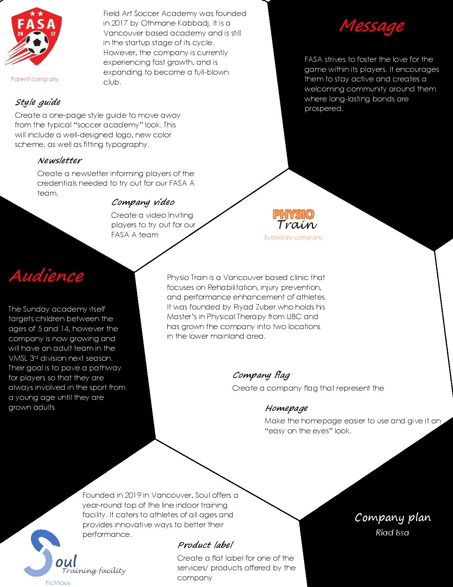
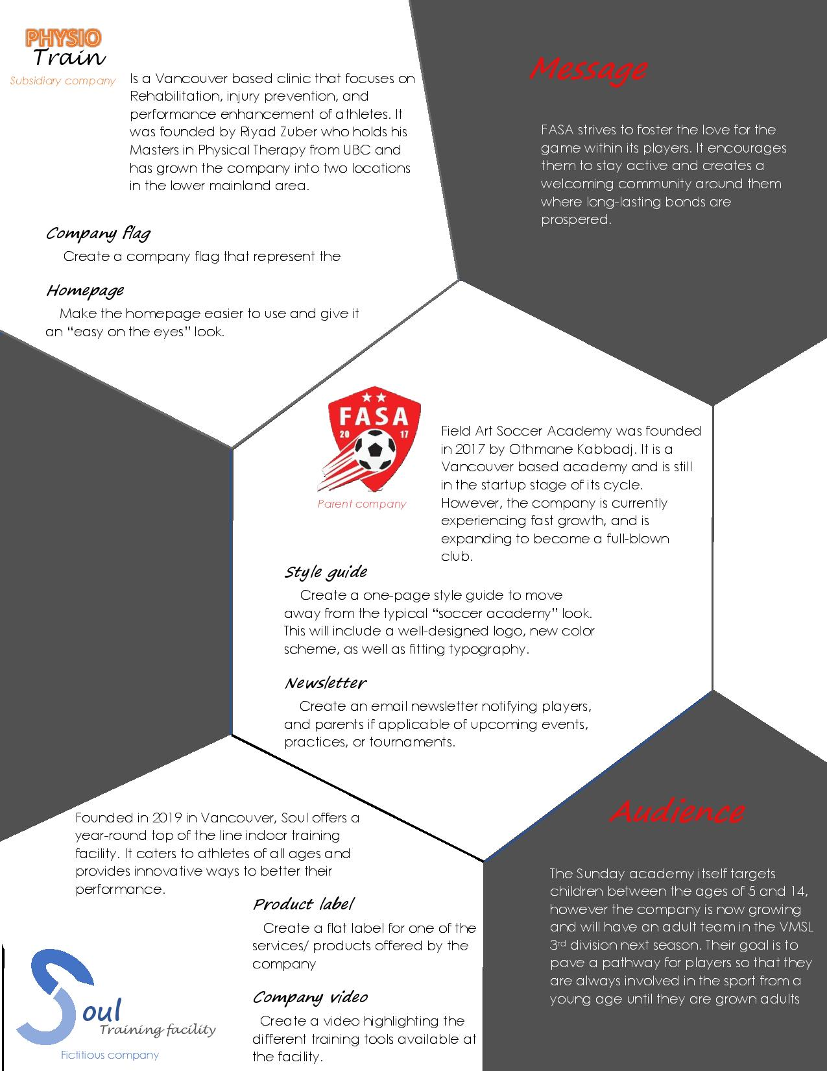

Slide 5
Style Guide

Slide 6
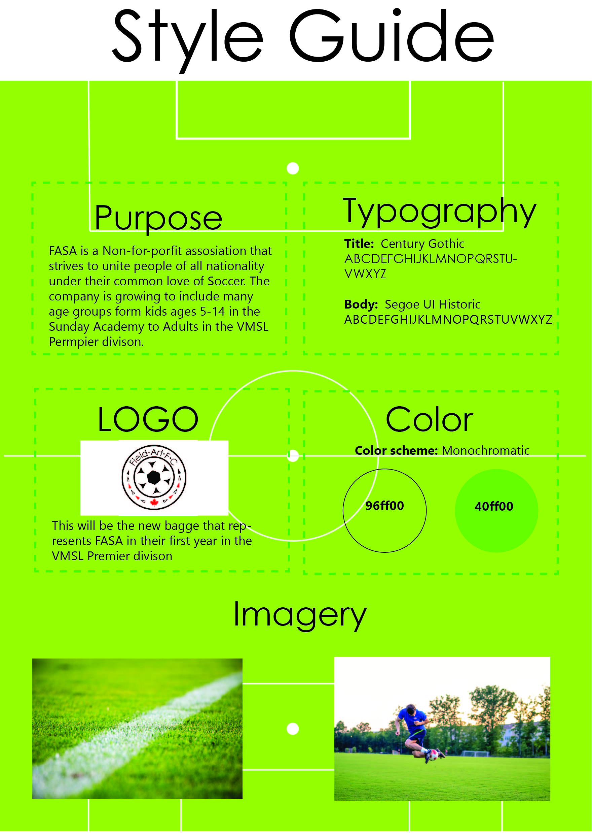
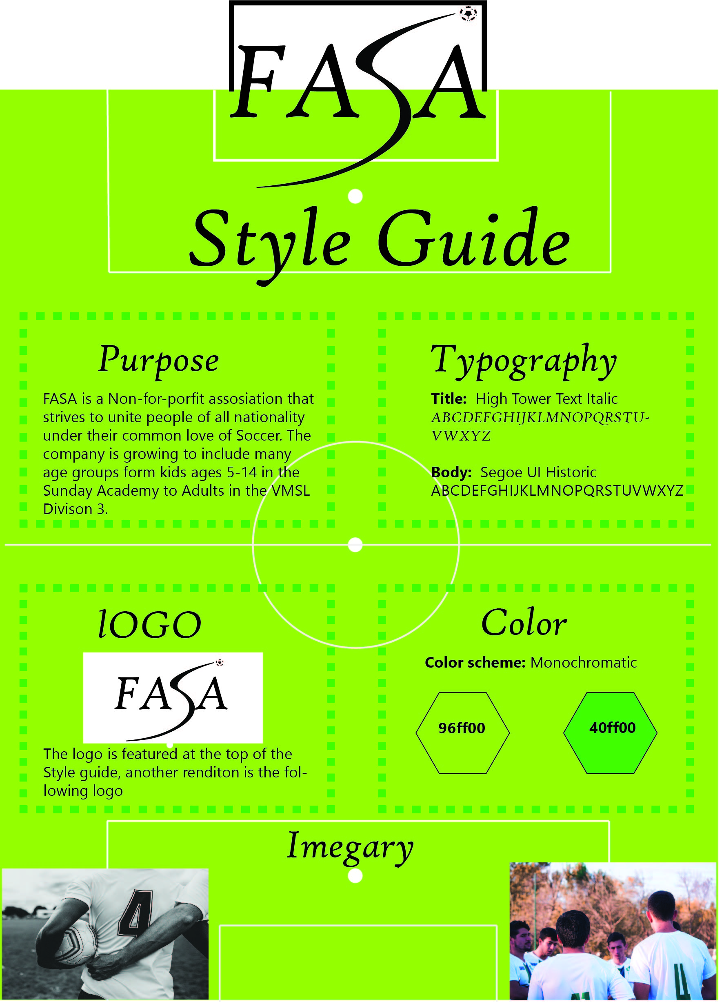

Slide 7
FASA BADGE

Slide 8
Newsletter

Slide 9

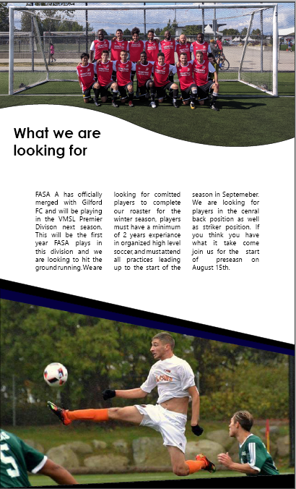

Slide 10
Company Video

Slide 11

Tryout video

Slide 12
Homepage

Slide 13



Slide 14
Company Flag

Slide 15



Slide 16
oul
Training facility
Fictitious company
Product Label

Slide 17
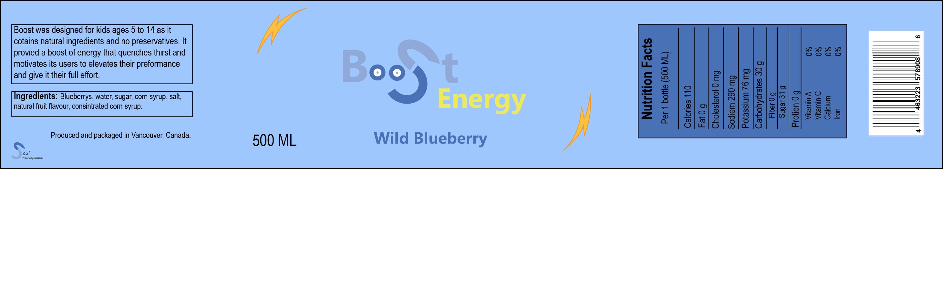
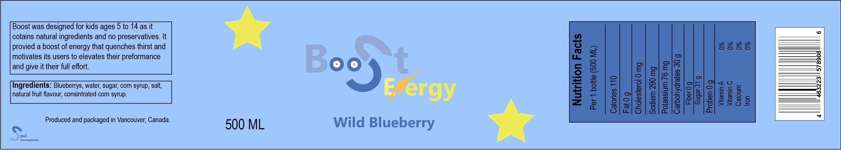

Slide 18


Questions?

